Slide 1
“ECG Signal Beat Classification ”

Slide 2
Team Members
Aya Mohamed Abdel-Azeem
Mohamed Bashar
Kerollos Nabil
--------------------------------------------------------------------------------------------------------------------------
Supervisor
Dr/Ibrahim
Eng/Maha

Slide 3
Data Base : European ST-T
79 subjects.
70 men aged 30 to 84
8 women aged 55 to 71
1 missed subject information
Each record is two hours in duration and contains two signals
sampled at 250 samples per second
https://physionet.org/content/edb/1.0.0/

Slide 4
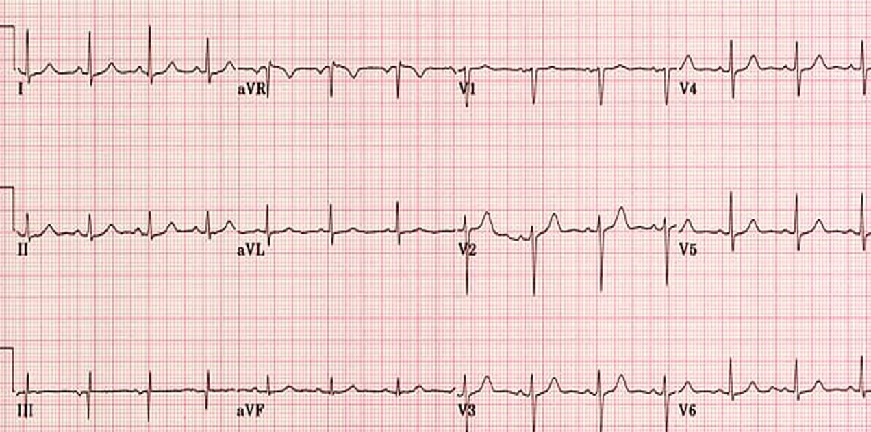

Slide 5
Project
Data Base
Files Extraction
Signal Selection
Preprocessing
Spliting Beats & Encoding Labels
Normalization
Wiener Filter
Denoising Wavelet
Modeling
Data Splitting
Fitting Model
Results Visualization
ROC Graph
Report Classification
Confusion Matrix
Evaluation & Prediction

Slide 6
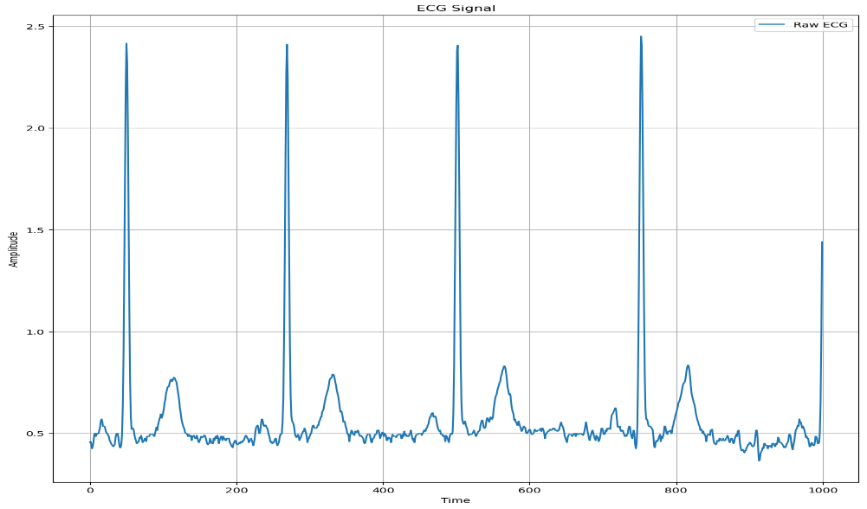
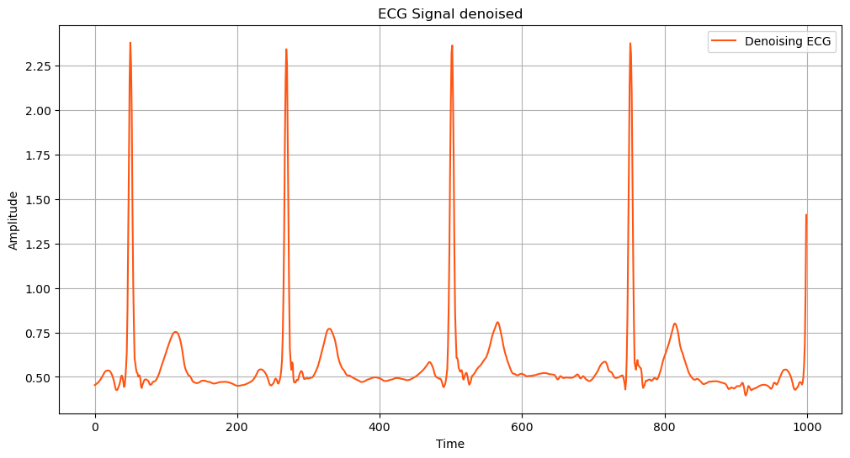
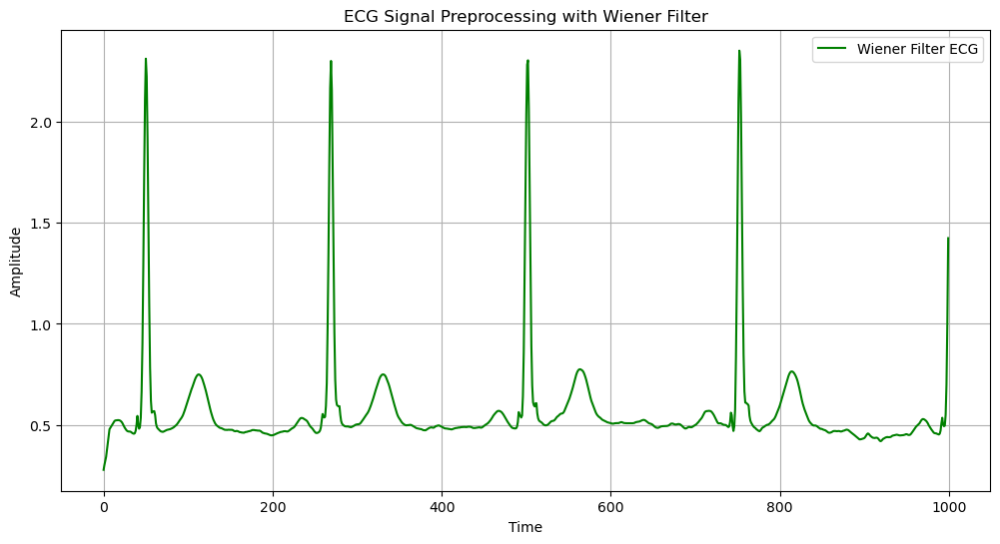
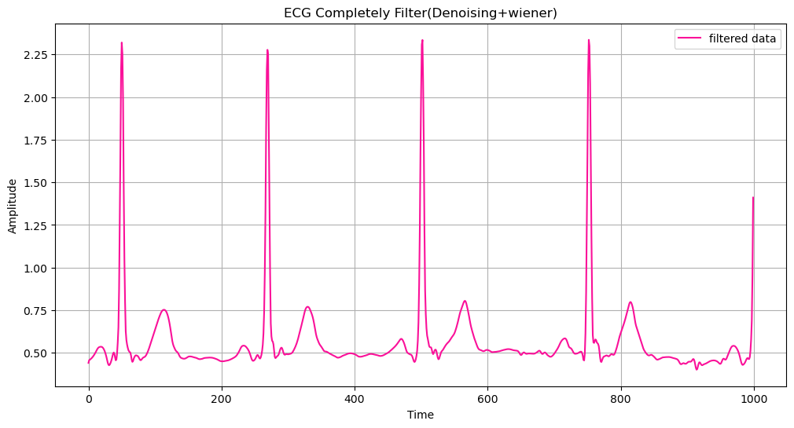
Preprocessing Data

Slide 7
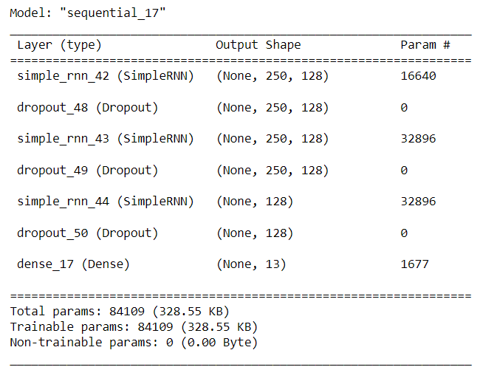
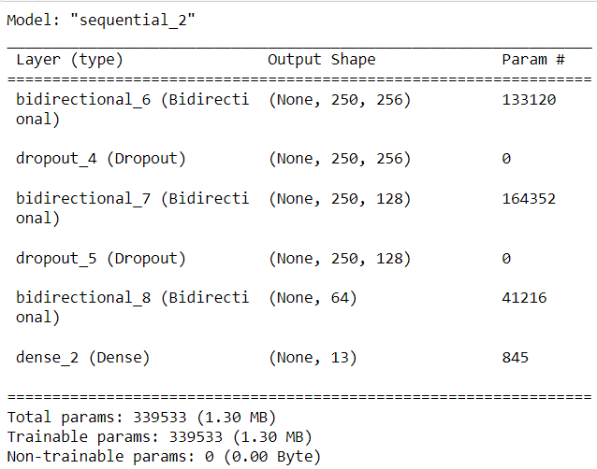
Modeling
RNN Model
LSTM Model

Slide 8
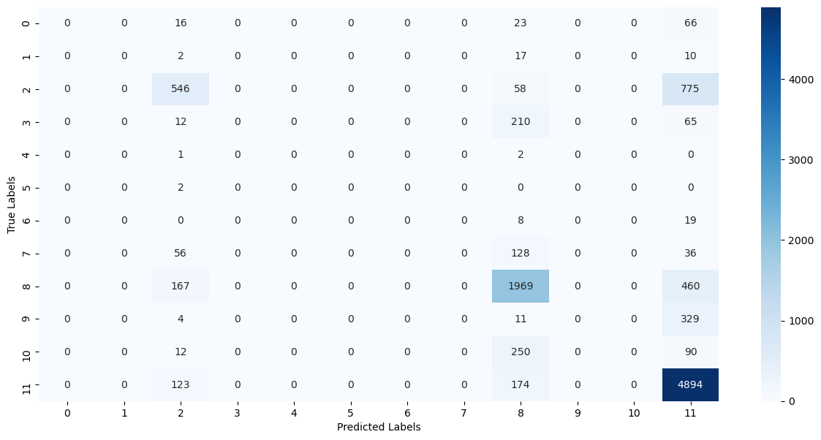
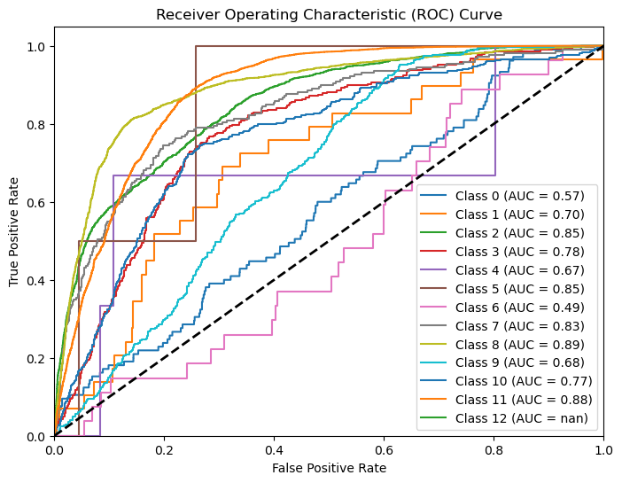
Results Visualization
RNN Results Visualization

Slide 9
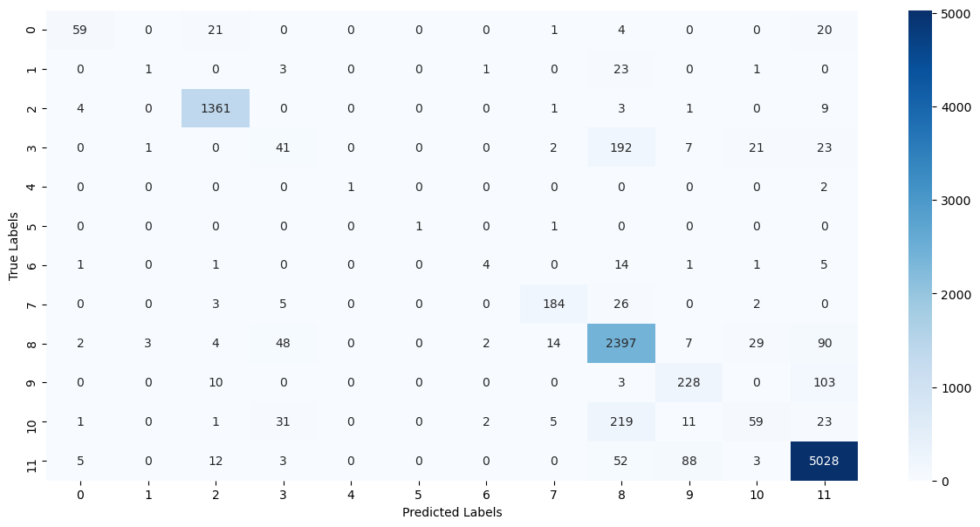
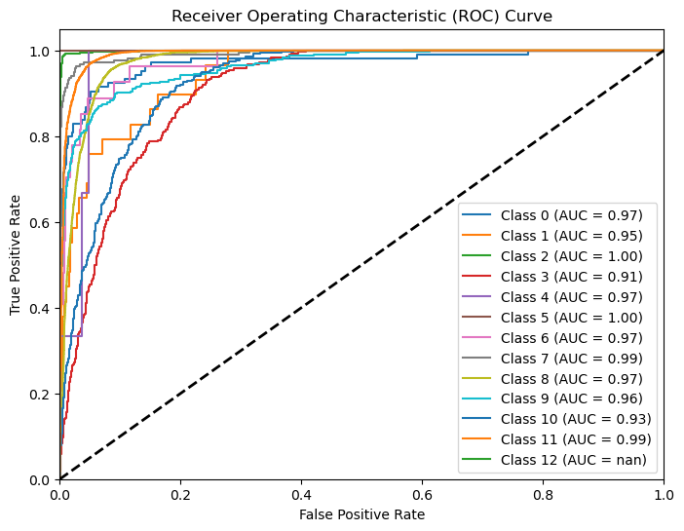
Results Visualization
LSTM Results Visualization

Slide 10

Thank you!

